Slide 1

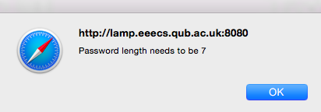
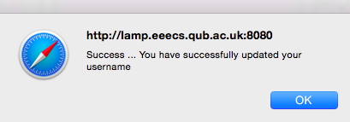
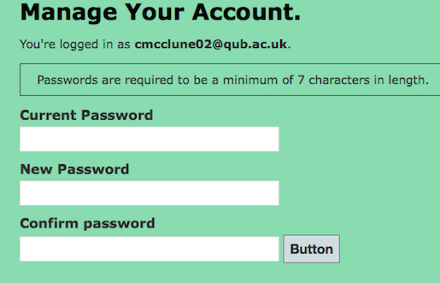
Manage Account – Reset Password
The version and © information omitted
Validation fix
Miscommunication
Inconsistency
Majority of defects cosmetic → moderate

Slide 2
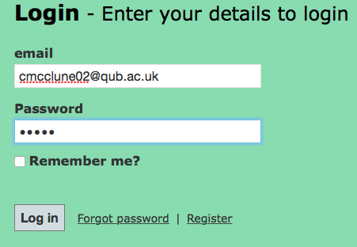

Login
Login page is mostly well structured
Few problems
User able to login with password less than specified 6 characters
Validation is server side rather than client side.

